Slide 1

Maverik Time Series Forecasting
Daryle Bilog
Joe Sarnello
Sanskriti Bhargava
Vinay Kumar Vascuri

Slide 2

Business Problem
Forecast first year sales for a new store based on the historical data.
Enable well informed financial decision-making.
Create more accurate initial ROI documents.

Slide 3
Objective
Build a model that:
Produces a daily level forecast for each of the sales metrics.
Updates the forecast as new data comes in.

Slide 4
About the Model
XGBoost
Handles Qualitative data, and non-linear relationships

Slide 5
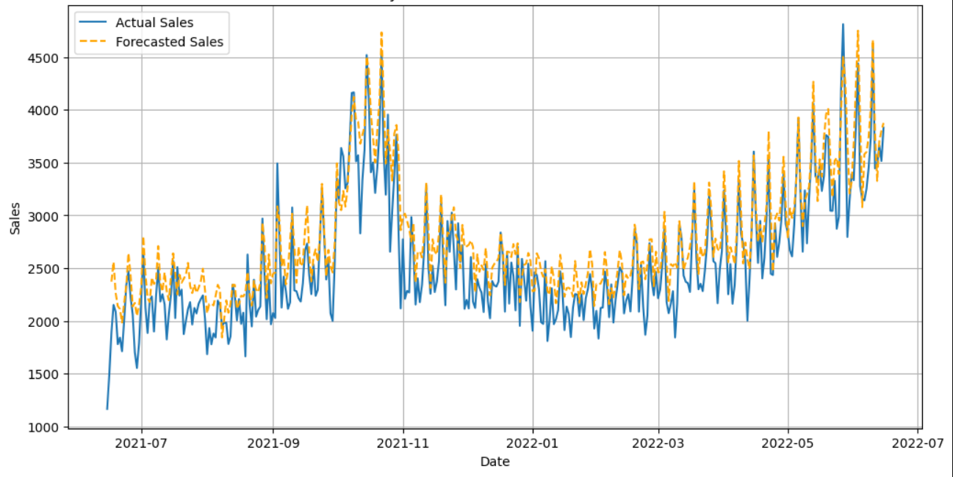
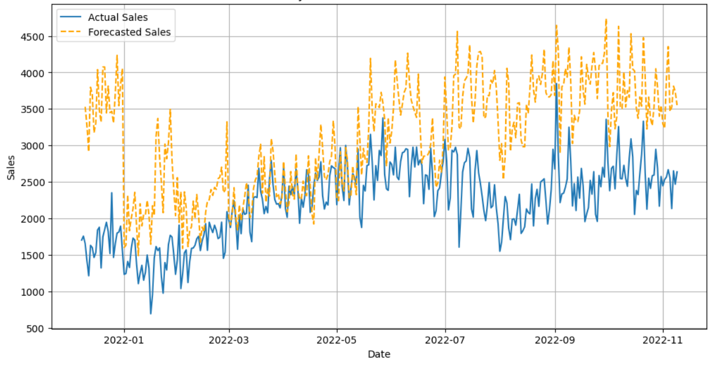
Total Inside Sales forecast from Day 1
22120
22855

Slide 6
Total Inside Sales
 | Maverik Benchmark | Store ID: 22855 | Store ID: 22120
2-Week Pred RMSE | 268521 | 256900 (4.3%) | 24947 (90.72%)
3-Week Pred RMSE | 243858 | 74557 (69.42%) | 59781 (75.44%)

Slide 7
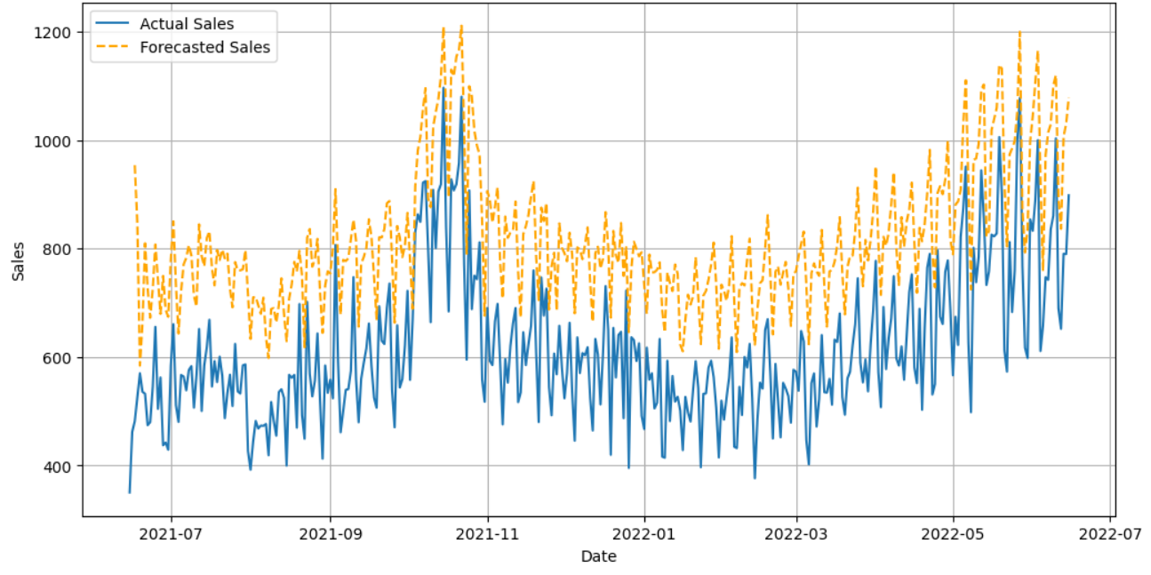
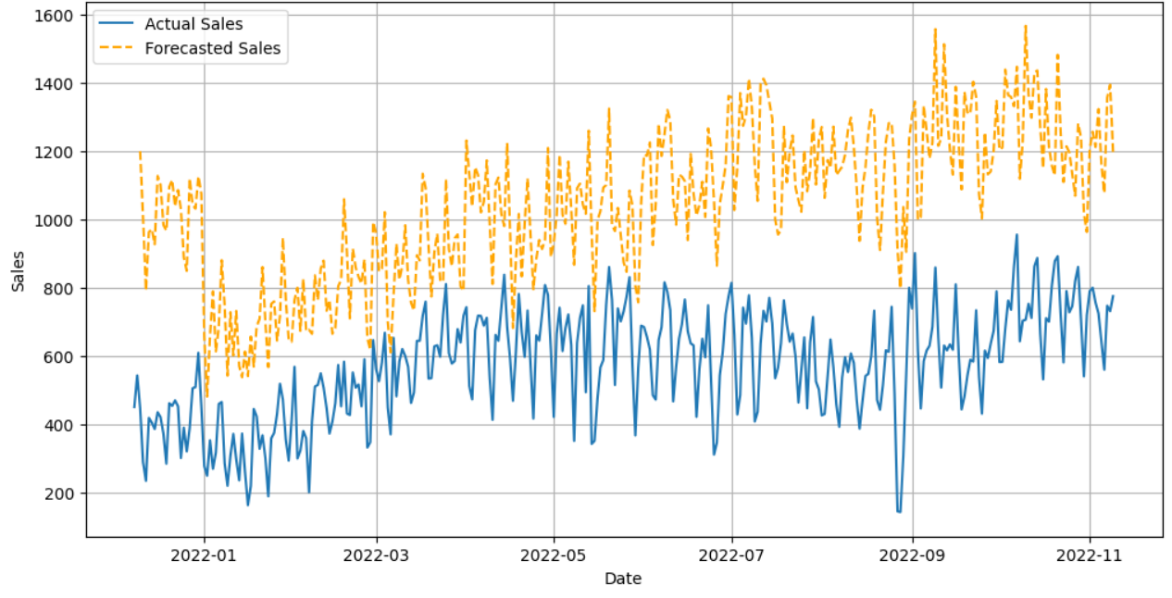
Total Food Sales forecast from Day 1
22120
22855

Slide 8
Total Food Service Sales
 | Maverik Benchmark | Store ID: 22855 | Store ID: 22120
2-Week Pred RMSE | 68860 | 94836 (37.44%) | 8156 (88.15%)
3-Week Pred RMSE | 66252 | 37029 (44.07%) | 1928 (97.1%)

Slide 9
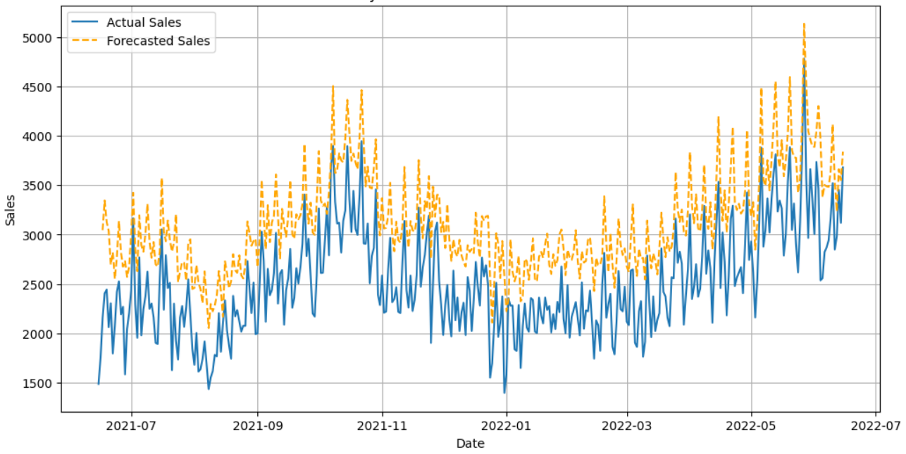
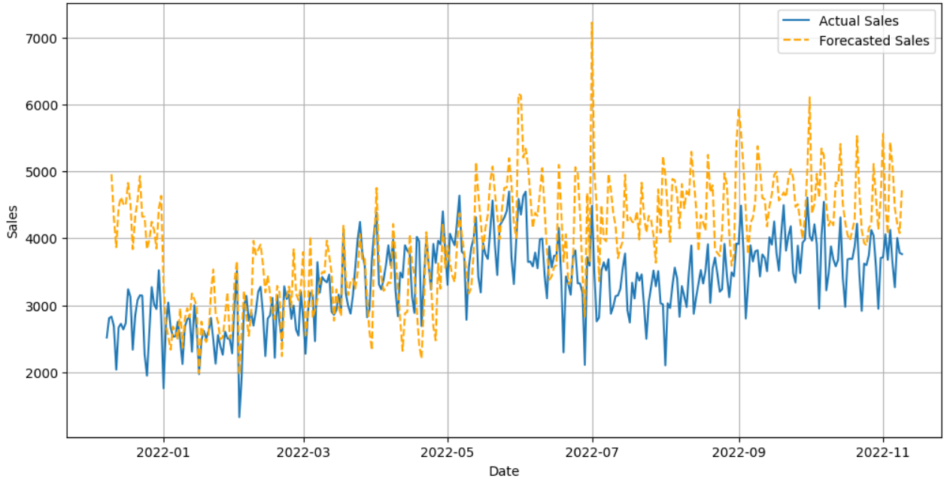
Total Unleaded sales from Day 1
22120
22855

Slide 10
Unleaded Sales
 | Maverik Benchmark | Store ID: 22855 | Store ID: 22120
2-Week Pred RMSE | 302827 | 95811 (68.36%) | 392773 (22.83%)
3-Week Pred RMSE | 259909 | 37976 (85.39%) | 421755 (62.09%)

Slide 11
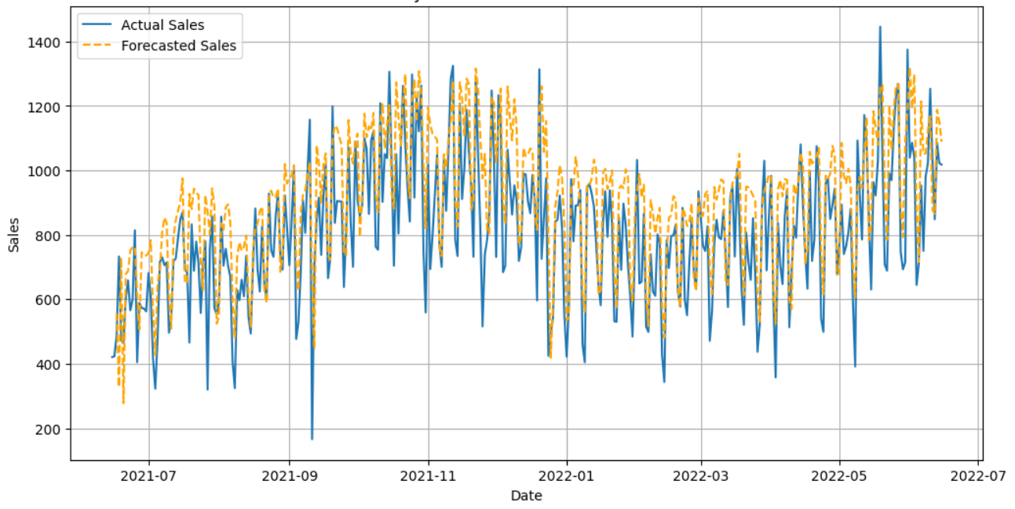
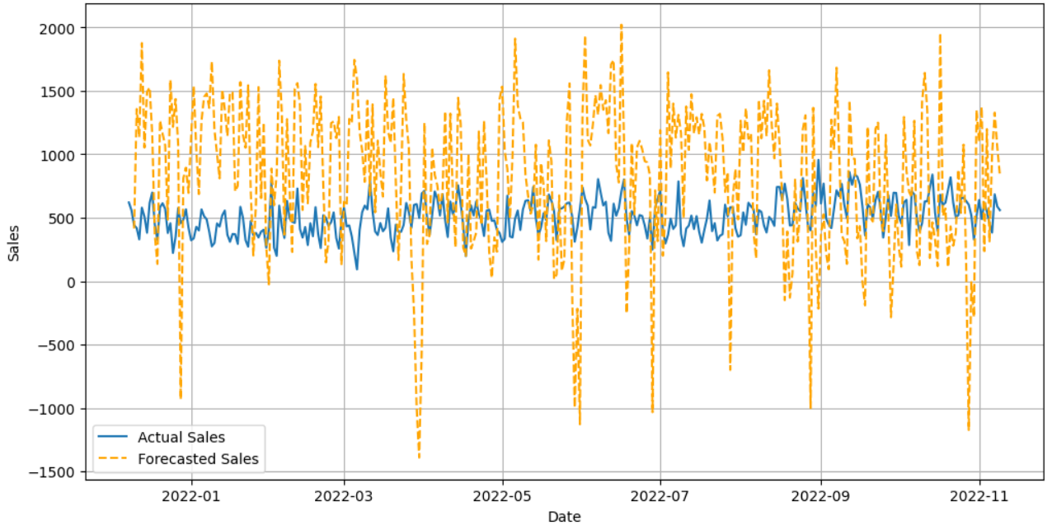
Total Diesel sales from Day 1
22120
22855

Slide 12
Diesel Sales
 | Maverik Benchmark | Store ID: 22855 | Store ID: 22120
2-Week Pred RMSE | 558546 | 570140 (2.08%) | 320856 (42.57%)
3-Week Pred RMSE | 482976 | 389503 (19.38%) | 339429 (29.62%)

Slide 13






Features of an Ideal New Store
Square_feet > 4970
Parking_space > 25
f’real
Traditional fueling positions >19
1 mile radius median income > $40,000
1 mile radius population > 7,500

Slide 14
Forecasted Outcome/Business Value
Inside Sales | Food Sales | Unleaded Sales | Diesel Sales
$867,003.87 | $214,006.12 | $3,335,149.28 | $979,496.56
Unleaded - $3.14/gal
Diesel - $4.1/gal
Sum of all 4 Target variables - $5,395,655.83

Slide 15
Thank you!

